Slide 1
individual Projects
Shenghang Zhu

Slide 2
Agenda
BikeCrossing
Core concept
Demo
Q & A
DocScanner
Core concept
Demo
Q & A

Slide 3
BikeCrossing

Slide 4
BikeCrossing
Core concept
Sustainable bike-sharing platform
Mentality shifting from renter to co-owner

Slide 5
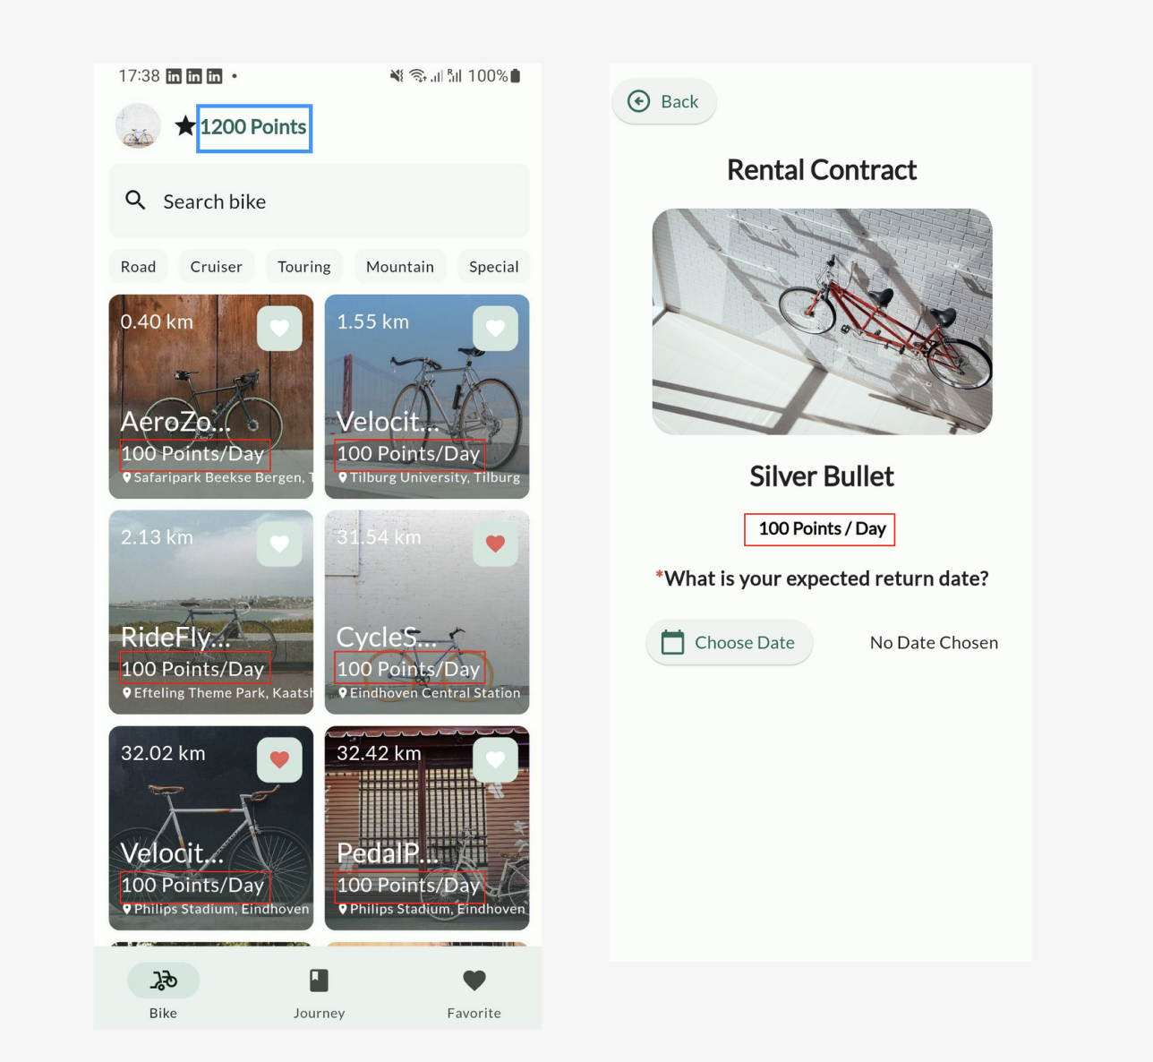
BikeCrossing
Sustainable bike-sharing platform
Point ecosystem system

Slide 6
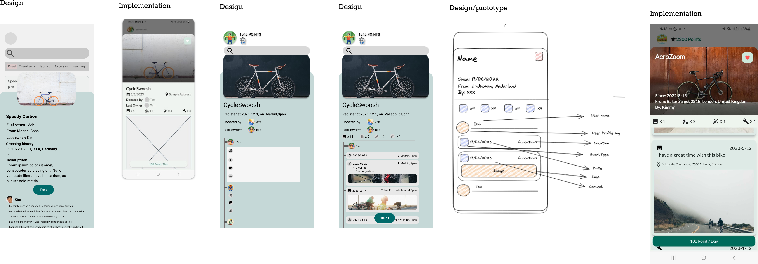
BikeCrossing
Mentality shifting from renter to co-owner
Story of the bike

Slide 7
DocScanner
Demo

Slide 8
Q & A

Slide 9
DocScanner

Slide 10
DocScanner
Core concept
An AI assistant helps non-native speakers quickly understand documentation, letter, and email etc.

Slide 11
DocScanner
Demo

Slide 12
Q & A

